Slide 1
Chapter 1
Introduction:
The Nature of Leadership

Slide 2
Learning Objectives
Understand why leadership has been defined in so many different ways.
Understand the controversy about differences between leadership and management.
Understand how leadership will be defined in this book.
© 2002 Prentice Hall, Inc.

Slide 3
Learning Objectives
Understand why it is so difficult to assess leadership effectiveness.
Understand the different indicators used to assess leadership effectiveness.
Understand what aspects of leadership have been studied the most during the past 50 years.

Slide 4
Learning Objectives
Understand how leadership can be described as an individual, dyadic, group, or organizational process.
Understand the organization of this book.

Slide 5
Definitions of Leadership
Past definitions have included traits, behaviors, influence, interaction patterns, role relationships, and occupation of an administrative position.

Slide 6
My Personal Favorite
Lao Tzu: A leader is best when people barely know he exists, Not so good when people obey and acclaim him, Worse when they despise him. But of a good leader, who talks little, When his task is done, his aim fulfilled, they will all say, we did it ourselves.
Notes:
Instruct them to look at the process model on page 5
Leader – person who takes charge and guides the performance or activity
Follower – person who performs under the guidance and instruction of a leader
Context – is the situation, formal or informal, social or work, dynamic or static.
By-products – nearly anything arising from interplay between the leader-follower and leader-situation

Slide 7
Defining Differences
Specialized Role or Shared Influence Process
Type of Influence Process
Purpose of Influence Attempts
Influence Based on Reason or Emotions
Leadership versus Management

Slide 8
Definition of leadership
A leader is any person who influences individuals and groups within an organization, helps them in the establishment of goals, and guides them toward achievement of those goals, thereby allowing them to be effective.

Slide 9
Keys Elements of the Definition of Leadership
Leadership is a group phenomenon
Leaders guide and influence others
Leadership involves some form of hierarchy in the group

Slide 10
Definition of Leadership Effectiveness
Leader are effective when their followers achieve their goals, can function well together, and can adapt to the changing demands from external forces.

Slide 11
Leaders are Effective When:
The group achieves its goals
Internal processes are smooth
The group can adapt to external forces

Slide 12
Effective vs. Successful Managers
Effective Managers
Satisfied followers
Productive
Focus on communication
Active conflict management
Motivate, train and develop employees
Successful Managers
Quick promotions
Focus on networking
Interact with outsiders
Socialize
Active in office politics

Slide 13
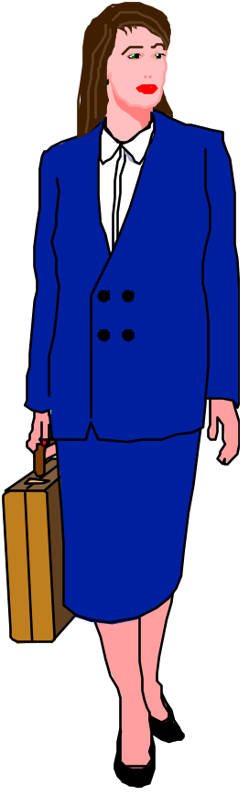
Key Leadership Variables
Characteristics of the leader
Characteristics of the followers
Characteristics of the situation

Slide 14

Definition of Culture
Commonly held values within a group of people
Set of norms, customs, values, and assumptions
Guides behaviors
Makes a group unique
Makes a group different from other groups

Slide 15




Three Levels of Culture
v
Organizational
culture
Organizational
culture
Organizational
culture
Organizational
culture

Slide 16
Hofstede’s Cultural Dimensions
Power distance
Uncertainty avoidance
Individualism
Masculinity
Time orientation

Slide 17
Hosftede’s Individualism/Collectivism
In collectivist cultures:
Self-defined as dependent on in-group
Group’s goals are given priority over individual’s
Social norms determine social behavior
Relationships based on communal terms
Friend and self are close
Enemy is far
OK to lie to out-group members

Slide 18
Hosftede’s Individualism/Collectivism (cont’d)
In individual cultures:
Self is autonomous from group
Personal goals are given priority over
in-group’s
Attitudes determine social behavior
Relationships based on exchange
Others are far and removed from self

Slide 19
Hosftede’s Individualism/Collectivism (cont’d)
Horizontal: Emphasis on equality
Vertical: Emphasis on hierarchy

Slide 20
Hosftede’s Individualism/Collectivism (cont’d)
Vertical
Collectivist (VC)
Rank and status among members
Obedience to authority
Sacrifice of self
Horizontal
Collectivist (HC)
Members are equal
No hierarchy
Consensus

Slide 21
Hosftede’s Individualism/Collectivism (cont’d)
Vertical
Individualist (VI)
Individual considered unique and superior to other individuals
Horizontal
Individualist (HI)
Individual considered unique, but not superior to others

Slide 22
Trompenaars’ Cross-Cultural
Organizational Cultures
Egalitarian
INCUBATOR
Individual-oriented
Leader removes
obstacles
Focus on individual
growth
GUIDED MISSILE
Performance-oriented
Leader is a guide
Focus on achieving
common goal
Person
Task
FAMILY
Power-oriented
Leader is caring
parent
Focus on building
relationships
EIFFEL TOWER
Rigid and robust
Leader is undisputed
legitimate boss
Focus on rational
performance
Hierarchical

Slide 23
Obstacles To Effective Leadership
Environmental uncertainty
Organizational rigidity
Lack of opportunity to practice
Relying on simplistic solutions
Inaccessible research

Slide 24
Management And Leadership
Leaders
Focus on the future
Create change
Create a culture based on shared values
Establish emotional link with followers
Use personal power
Managers
Focus on the present
Maintain status quo
Implement policies and procedures
Remain aloof and maintain objectivity
Use position power

Slide 25

Leadership vs.. Management
Leadership & management are distinct, yet complementary systems of action
Effective leadership
produces useful change
Effective management controls complexity
Effective leadership + good management = healthy organizations
Notes:
3

Slide 26
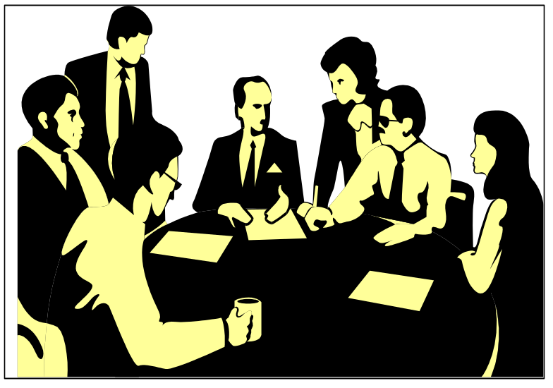
Management Process
Reduces uncertainty
Provides stability
Components
  Planning & budgeting
  Organizing and staffing
  Controlling & problem
  solving
Notes:
4

Slide 27
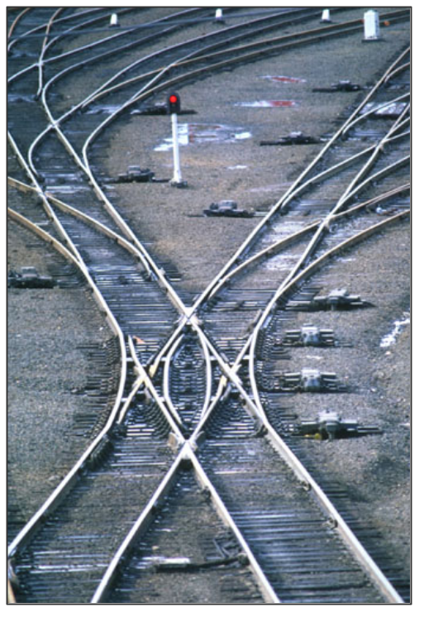
Leadership Process
Creates uncertainty
Creates change
Components
  Setting organizational direction
  Align people with the direction via
  communication
  Motivate people to action
    Empowerment
    Need gratification
Notes:
5

Slide 28
Leader’s Function In Shaping
Organizational Culture
LEADER
Role Reward Hiring Structure
Model System Decisions & Strategy
CULTURE

Slide 29
Arguments Over The Impact Of Leadership: Leadership Is Insignificant
Outside environmental factors affect organizations more than leadership
Internal structure and strategy determine the course organizations take
Leadership only accounts for 7% to 15% of performance

Slide 30
Arguments Over The Impact Of Leadership: Leadership Is Insignificant
Leaders have little discretion to really make an impact
Leadership is a romantic myth rather than a real organizational factor

Slide 31
Arguments Over The Impact Of Leadership: Leadership Has an Impact
Leadership is one of many important factors
Leadership is key in providing vision and direction
Leadership is critical in orchestrating change

Slide 32
Arguments Over The Impact Of Leadership: Leadership Has an Impact
Leadership can account for up to 44% of a firm’s profitability
Leadership is critical in orchestrating change
Leadership’s impact is moderated by situational factors

Slide 33
A model
Situational Variables
Leader
Behavior
Influence
Processes
Follower Attitudes
and Behaviors
Leader Traits
and Skills
Performance
Outcomes

Slide 34
Major Research Approaches
Trait Approach
Behavior Approach
Power-Influence Approach
Situational Approach
Integrative Approach

Slide 35

Leadership Theories
What is Leadership?
  The ability to influence a group towards the achievement of goals.

Slide 36

“We want all our leaders - from politicians
to movie stars - to stir our souls a little, and
we want the same thing from our managers.
They have become the most significant
figures in our society, with as central a role
to play as generals, lords, oracles, or politicians played in centuries past, and we look to them for more than guidance.” T. Leal (1996).
“Today, the subject of leadership is central to any discussion of the modern organization.” P. L. Brill, R. Worth (1997).
“Great leaders don’t just ride waves, they make them.” W. Bennis (1996).

Slide 37
Leadership Process
  Managers exercise leadership behavior to influence subordinates’ behavior to achieve goal directed results.

Slide 38
Leader and Follower Attributions Influence Leadership Outcomes
Information Cues
Distinctiveness
Consistency
Consensus
Perceived Source
of Responsibility
Causal Attribution
of Poor Quality
Internal Causes
Low Effort
Low Commitment
Lack of Ability
External Causes
Improper Equipment
Unfair Deadlines
Illness of Production
Team Members
Observation of
Poor Quality of
Production
Rejects
Excess Scrap
Returned Products
Excessive
Production Costs
Leader Behavior
in Response to
Attributions
Reprimand
Transfer
Demotion
Redesign Job
Personal Concern
Training
Link #1
Link #2

Slide 39
Leadership Theory Typology
Degree of generalizability
Universal
Contingent
Traits
Type I
Type III
Leader
attribute
Behaviors
Type II
Type IV
Reprinted by permission, A. G. Jago, “Leadership Perspectives in Theory and Research,” Management Science 22 (1982): 316. Copyright© 1982, The Institute of Management Sciences (currently INFORMS), 901 Elkridge Landing Road, Suite 400, Linthicum, Maryland 21090-2909 USA.
Notes:
6

Slide 40

General Categories of Leadership Traits from the Trait Era
Capacity
Achievement
Responsibility
Participation
Status
Situation

Slide 41

Capacity
Intelligence
Alertness
Verbal facility
Originality
Judgment

Slide 42


Scholarship
Knowledge
Athletic accomplishment
Achievement

Slide 43

Responsibility
Dependability
Initiative
Persistence
Self-confidence

Slide 44

Participation
Activity
Sociability
Cooperation

Slide 45

Status
Socioeconomic position
Popularity

Slide 46

Situation
Mental level
Interest in followers
Objectives

Slide 47
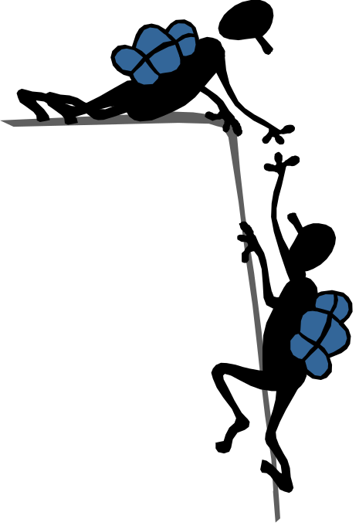

Transactional & Transformational Leadership
As a
transactional leader,
I use formal rewards
& punishments.
As a
transformational leader,
I inspire and excite
followers to high levels
of performance.
Notes:
8

Slide 48


Leaders as Distinct Personalities
Leader - an advocate for change & new approaches to problems
Manager - an advocate for stability & the status quo
Do not rock
Notes:
9

Slide 49
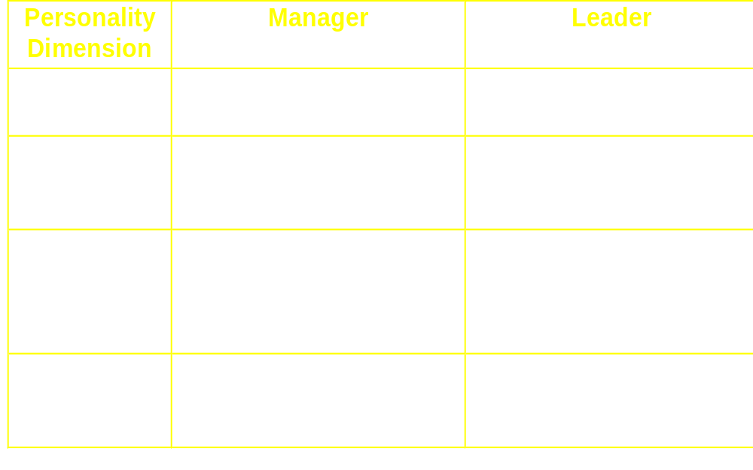
Leaders & Managers
Notes:
10

Slide 50
Charismatic Leadership
Charismatic leadership - the use, by a leader, of personal abilities & talents in order to have profound & extraordinary effects on followers
Charisma - gift in Greek
Charismatic leaders use referent power
Potential for high achievement & performance
Potential for destructive & harmful courses of action
Notes:
12

Slide 51

Transactional Leaders
Contingent Reward
Management by Exception
Laissez-Faire
Traditional Style of Leadership

Slide 52

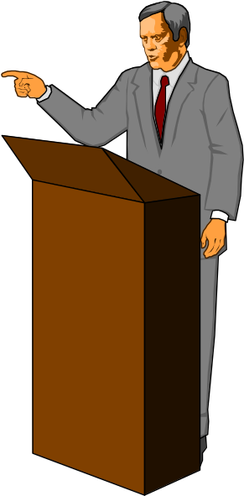
Characteristics of Charismatic Leaders
Self-confidence
Vision
Ability to articulate the vision
Strong convictions about the vision
Behavior that is often out of the ordinary
Perceived as being a change agent

Slide 53
Transformational Leadership
Charisma
Inspiration
Vision
Intellectual Stimulation
Individualized Consideration

Slide 54
Transactional vs. Transformational
Transactional leaders guide or motivate their followers in the direction of established goals by clarifying role and task requirements.
Transformational leaders provide individualized consideration, intellectual stimulation, and possess charisma.
Transformational leadership builds on top of transactional leadership.

Slide 55

Current View Of Key Leadership Traits
Drive and energy
Desire and motivation to lead
Honesty and integrity
Self-confidence
Intelligence
Knowledge of the business

Slide 56
Type II Universal Behavior
Theories of Leadership
Universal behavior theories - discriminate the leaders’ actions from the followers’ perspective
Early Type II theories
  classified leaders by style: autocratic, democratic, or laissez-faire
Current Type II theories
  examine common behavior dimensions of all leaders
  help organizations train & develop leaders rather than select them
Notes:
13

Slide 57


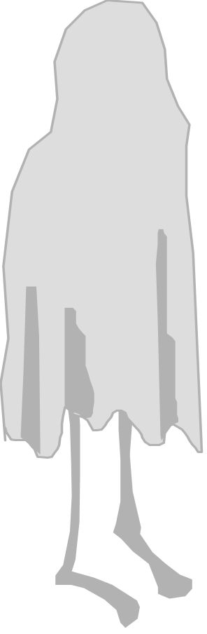
Leadership Style &
Emotional Climate
Autocratic style - the leader uses strong, directive, controlling actions to enforce the rules, regulations, activities, &
relationships in the work environment; followers have little discretionary influence
Democratic style - the leader takes collaborative, reciprocal, interactive actions with followers; followers have high degree of discretionary influence
Laissez-fair style - the leader fails to accept the responsibilities of the position; creates chaos in the work environment
Notes:
14

Slide 58
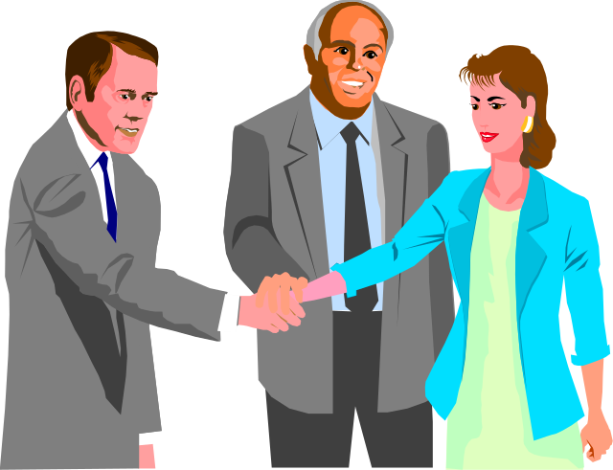
University of Michigan
Production Centered
  emphasize technical or task aspects.
Employee Centered
  emphasizing interpersonal relations.

Slide 59
Leadership Behaviors – Ohio State Studies
Initiating structure - leader behavior aimed at defining & organizing work relationships & roles, as well as establishing clear patterns of organization, communications, & ways of getting things done
Consideration - leader behavior aimed at nurturing friendly, warm working relationships, as well as encouraging mutual trust & interpersonal respect within the work unit
Notes:
15

Slide 60
The Ohio State Studies Suggested that Leaders High on Both Initiating Structure and Consideration Had the Best Outcomes
MANAGER’S INITIATING STRUCTURE
HIGH
LOW
High Performance
Low Grievance Rate
Low Turnover
Low Performance
Low Grievance Rate
Low Turnover
HIGH
High Performance
High Grievance Rate
High Turnover
Low Performance
High Grievance Rate
High Turnover
LOW

Slide 61

Managerial Grid
High
9
8
7
6
5
4
3
2
1
Low
1.9
Country club
management
9.9
Team
management
Concern
for
People
5.5
Organization man
management
Authority-
obedience
management
9.1
Impoverished
management
1.1
“The Leadership Grid” from Leadership Dilemmas - Grid Solutions, by Robert R. Blake and Anne Adams McCanse. Huston: Gulf Publishing Company, p. 29. Copyright© 1991 by Scientific Methods, Inc. Reproduced by permission of the owners.
1 2 3 4 5 6 7 8 9 High
Concern for production
Notes:
17

Slide 62
Managerial Grid
Two Dimensions
Concern for
People
Concern for Production

Slide 63
The Managerial Grid
Country Club Management
  Thoughtful attention to needs of people for satisfying relationships leads to a comfortable friendly enterprise.
Impoverished Management
  Exertion of minimum effort to get required work done is appropriate to sustain enterprise membership.

Slide 64
Middle-of-the-Road Management
  Adequate enterprise performance is possible through balancing the necessity to get out work with maintaining morale of people at a satisfactory level.
Team Management
  Work accomplishment is from committed people; interdependence through a “common stake” in enterprise objectives leads to relationships of trust and respect.
Authority-Obedience
  Efficiency in operations results from arranging conditions of work in such a way that human elements interfere to a minimum degree.

Slide 65
9
1,9
Country Club Management
Thoughtful attention to needs
of people for satisfying relation-
ships leads to a comfortable,
friendly organization atmosphere
and work tempo.
9,9
Team Management
Work accomplishment is from
committed people, interdependent-
dence through a “common
stake” in organization purpose
leads to relationships of trust
and respect.
8
7
6
5
5,5
Organization Man Management
Adequate organization performance
is possible through balancing the
necessity to get out work with main-
taining morale of people at a
satisfactory level.
Concern for People
4
3
9,1
Authority-Obedience
Efficiency in operations results
from arranging conditions of
work in such a way that human
elements interfere to a mini-
mum degree.
1,1
Impoverished Management
Exertion of minimum effort to
get required work done is ap-
propriate to sustain organiza-
tion membership
2
1
1
2
3
4
5
6
7
8
9
Concern for Production

Slide 66
Major Leader Behaviors
Structuring/Task
Setting goals
Making expectations clear
Setting schedules
Assigning work
Consideration/People
Empathy and understanding
Friendly and approachable
Participative
Nurturing

Slide 67
Basic Assumptions Of The
Contingency Approach To Leadership
No one best way
Understanding the situation is key
People can learn to become better leaders
Leadership makes a difference
Both personal and situational factors affect leadership effectiveness

Slide 68
Type III Contingency
Theories of Leadership
Contingency theories - concerned with identifying the situationally specific conditions in which leaders with particular traits are effective
Central concern - how the leader’s traits interact with situational factors in determining team effectiveness in task performance
leader
situation
Notes:
18

Slide 69
Fiedler’s Contingency Theory
Fiedler’s Contingency Theory - classifies the favorableness of the leader’s situation
  leader’s position power - authority associated with the leader’s formal position in the organization
  structure of the team’s task - degree of clarity, or ambiguity, in the team’s work activity
  quality of the leader-follower (group members) interpersonal relationships
  least preferred coworker (LPC) - the person a leader has least preferred to work with over his or her career
Notes:
19

Slide 70
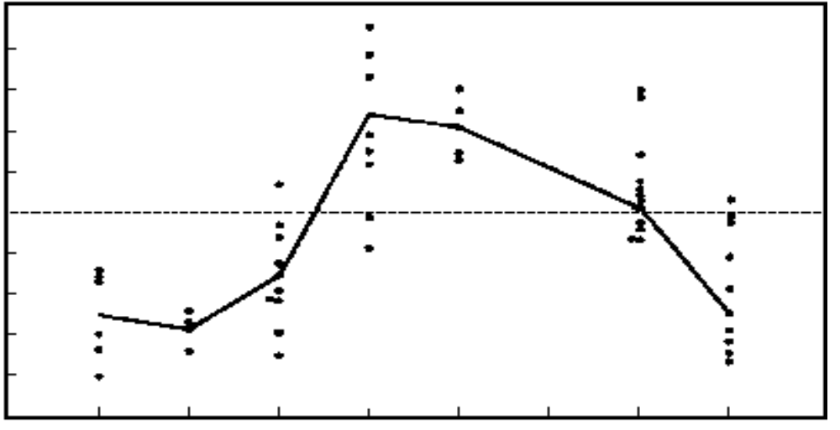

Leadership Effectiveness in the Contingency Theory
High LPC
relations oriented
1.00
.80
.60
.40
.20
0
-.20
-.40
-.60
-.80
Correlation
between leader
LPC & group
performance
Low LPC
task oriented
Unfavor-able for leader
Favorable
for leader
I II III IV V VI VII VIII
F. E . Fiedler, A Theory of Leadership Effectiveness (New York: McGraw-Hill, 1964.) Reprinted by permission.
Notes:
20

Slide 71
Vroom-Jago Model
Helps determine appropriate level of employee participation
Very practical means of assessing the situation
Five styles of Leadership

Slide 72
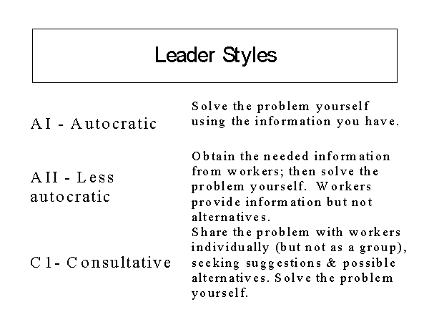

Slide 73
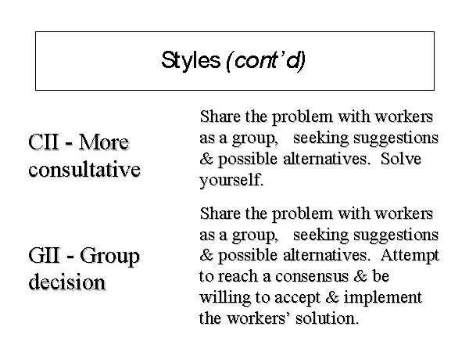

Slide 74
Seven Questions
A -Is there a quality standard that makes one alternative superior to another
B -Do I have enough information to make a good decision
C -Is the problem structured?
D - Must workers accept my decision if they are to implement it effectively?
E - If I make the decision alone, are workers likely to accept my decision?
F - Do workers share the firm’s goals?
G - Is conflict among workers likely among preferred solutions?

Slide 75
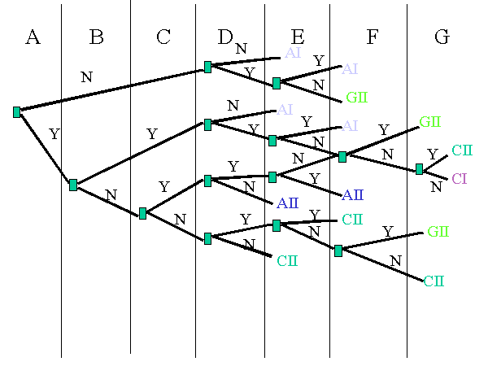

Slide 76
Path-Goal Theory of Leadership
Leader behavior styles
Directive
Supportive
Participative
Achievement oriented
Follower path
perceptions
Effort-Performance-
Reward linkages
Follower goals
Satisfaction
Rewards
Benefits
Follower
Characteristics
Ability level
Authoritarianism
Locus of control
Workplace
characteristics
Task structure
Work group
Authority system
Notes:
21

Slide 77

Path-Goal Theory
Environmental Contingency Factors
  Task Structure
  Formal Authority System
  Work Group
Leader Behavior Factors
  Directive
  Supportive
  Participative
  Achievement-Oriented
Subordinate Contingency Factors
  Locus of Control
  Experience
  Perceived Ability
OUTCOMES
  Performance &/or Satisfaction

Slide 78
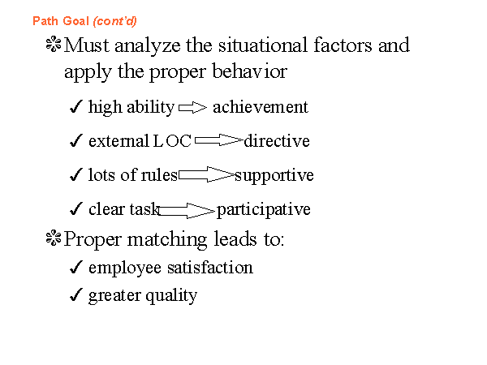

Slide 79




Hersey-Blanchard Situational
Leadership Model
Leader’s concern with task
Low
High
P. Hersey and K. H. Blanchard, Management of Organizational Behavior: Utilizing Human Resources, 3d ed., 1977, p. 170. Englewood Cliffs: Prentice Hall.
High
Leader’s
concern
with
relationship
Low
Mature
Employees
Immature
Employees
Willing/Able Unwilling/able
Willing/unable Unwilling/unable
4 3 2 1
Notes:
22

Slide 80
Hersey & Blanchard
Situational Leadership Theory
DIRECTIVE STYLE
  A leadership style characterized by the giving of clear instructions and specific direction to immature employees.
COACHING STYLE
  A leadership style characterized by expanding two-way communication and helping maturing employees build confidence and motivation.

Slide 81
Situational Leadership cont.
SUPPORTING STYLE
  A leadership style characterized by active two-way communication and support of mature employees' efforts to use their skills.
DELEGATION STYLE
  A hands-off leadership style characterized by giving responsibilities for carrying out plans and making task decisions to the highly mature employees.

Slide 82
Maturity or Readiness Level
Readiness Level One: Unable and unwilling or insecure -- Tell
Readiness Level Two: Unable but willing or confident -- Sell
Readiness Level Three: Able but unwilling or insecure -- Participate
Readiness Level Four: Able and willing or confident -- Delegate

Slide 83
Guidelines for Leadership
Unique attributes, predispositions & talents of each leader should be appreciated
Organizations should select leaders who challenge but not destroy the organizational culture
Leader behaviors should demonstrate a concern for people; it enhances follower well-being
Different leadership situations call for different leadership talents & behaviors
Good leaders are likely to be good followers
Notes:
23

Slide 84
Five Types of Followers
Independent, critical thinking
Alienated
followers
Effective
followers
Survivors
Passive
Active
Yes
people
Sheep
Source: R. E. Kelley, “In Praise of Followers,” Harvard Business Review 66 (1988): 145.
Independent, uncritical thinking
Notes:
24

Slide 85
Followership
Warren Bennis
Willingness to tell the truth - listening.
Organizations benefit from diversity.
Thoughtful dissent.

Slide 86
Followership
All organizations have far more followers than leaders, so ineffective followers may be more of a handicap to an organization than ineffective leaders.
What qualities do effective followers have?
  They manage themselves well.
  They are committed to a purpose outside themselves.
  They build their competence and focus their efforts for maximum impact.
  They are courageous, honest, and credible.

Slide 87
Dynamic Follower
Responsible steward of his or her job
Effective in managing the relationship with the boss
Practices self-management
Notes:
25

Slide 88

Level of Conceptualization
Individual
Dyad
Group
Organization

Slide 89
Contemporary Approaches
Charismatic Leadership
Gender Differences
Empowerment
Followership
Substitutes for Leadership
Is it Important?

Slide 90
Other Bases for Comparison
Leader vs.. Follower-centered Theories
Descriptive vs.. Prescriptive Theory
Universal vs.. Contingency Theory

Slide 91
Summary
Leadership is an influence process
In evaluating leader effectiveness, outcome variables differ according to researcher
Leadership studies vary based on the line of research and the level of conceptualization

Slide 92
Summary
Another basis for studying leadership includes the relative focus on the leader or the follower
Leadership theories can be prescriptive or descriptive, universal or contingent

